Slide 1
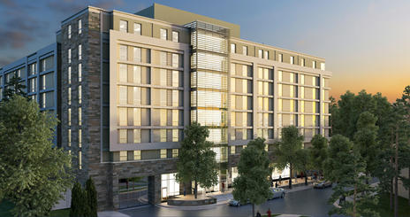
North Hall | American University| Washington D.C.
Penn State Architectural Engineering Senior Thesis Project
Brandon Tezak | Construction Management
Dr. Anumba | Facility Advisor

Slide 2
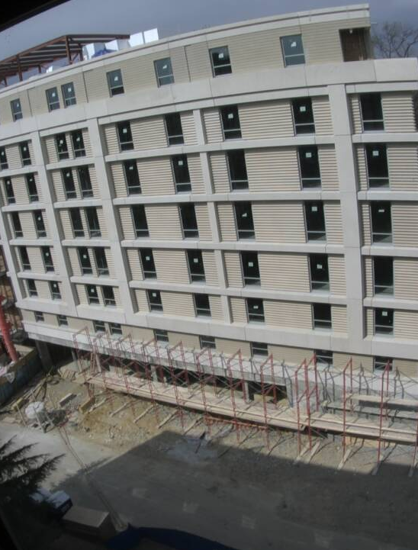
North Hall | American University |Washington D.C.
Brandon Tezak |Construction Management
Presentation Outline
Project Background
Analysis 1: Modularization of Suite Bathrooms
Analysis 2: GPS Tracking of Precast Panel
Analysis 3: Solar Panel Upgrade
Electrical Breadth
Analysis 4: Traditional Reinforced Concrete Slab
Structural Breadth
Summary of Conclusions & Acknowledgements

Slide 3
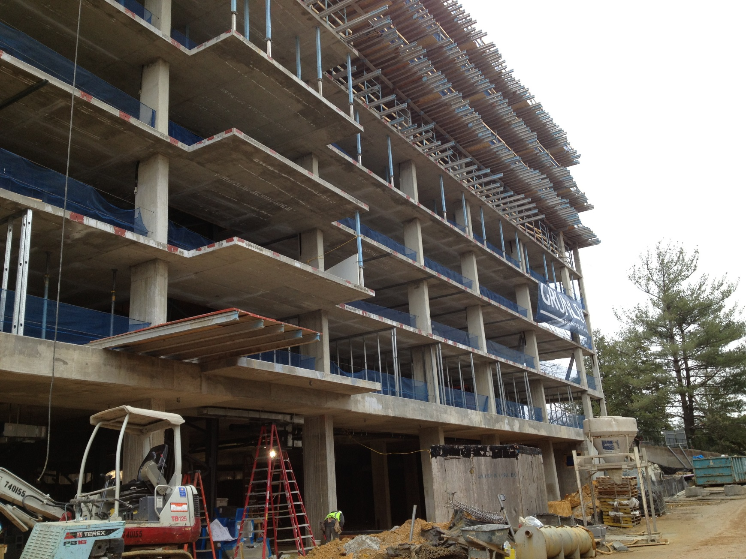
North Hall | American University |Washington D.C.
Project Background
North Hall | American University |Washington D.C.
Brandon Tezak |Construction Management
Brandon Tezak |Construction Management
Presentation Outline
8 Story New Dormitory
358 Beds
Suite Style Rooms
$29 Million
122,200 SF
May 15, 2012 - August 9, 2013
LEED Gold
Concrete Structure
Project Background
Modularization of Suite Bathrooms
GPS Tracking of Precast Panels
Solar Panel Upgrade
Traditional Reinforced Concrete Slab
Summary of Conclusions & Acknowledgements

Slide 4
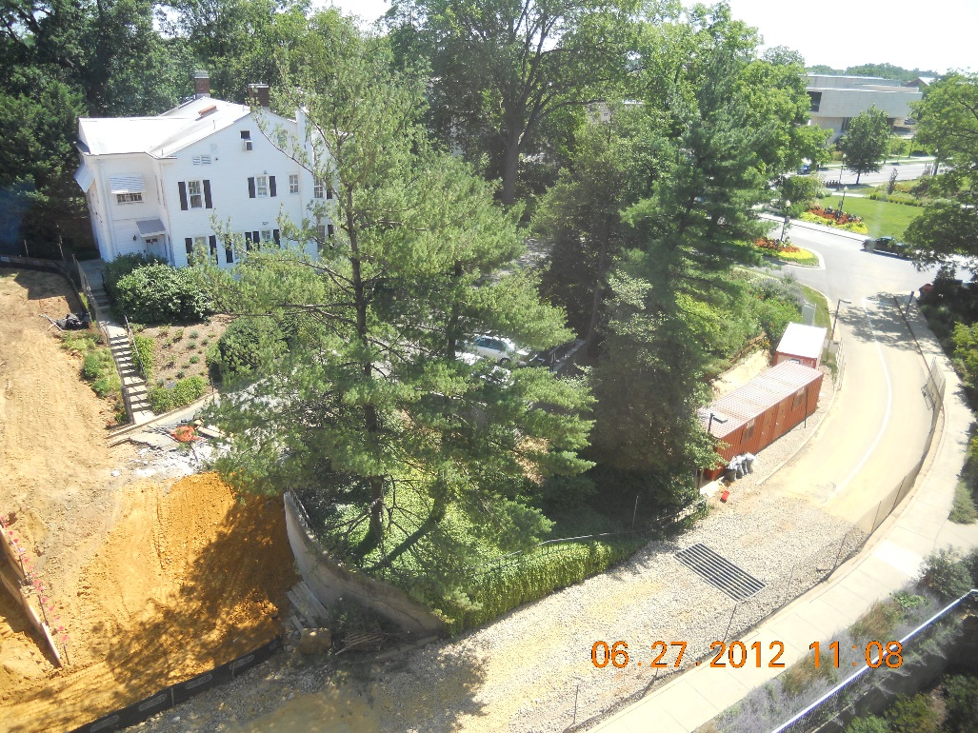
North Hall | American University |Washington D.C.
Modularization of Bathrooms
North Hall | American University |Washington D.C.
Brandon Tezak |Construction Management
Brandon Tezak |Construction Management
Presentation Outline
Problem Identification
Compressed Schedule
Small Site
Goals
Generate Cost Savings if Possible
Generate Schedule Savings
Reduce Congestion Onsite
Background
94 Total Suites
64 With Typical Bathroom Layout
Shower Room
Toilet Room
Vanity Area
Project Background
Modularization of Suite Bathrooms
GPS Tracking of Precast Panels
Solar Panel Upgrade
Traditional Reinforced Concrete Slab
Summary of Conclusions & Acknowledgements

Slide 5
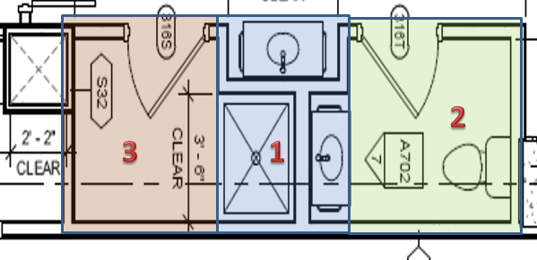
North Hall | American University |Washington D.C.
Modularization of Bathrooms
North Hall | American University |Washington D.C.
Brandon Tezak |Construction Management
Brandon Tezak |Construction Management
Presentation Outline
Module Constraints
Fit on Truck
Fit Through Unfinished Corridors
Handled & Moved Easily
Constructability
Interface with Stick Built Construction
3 Modules
Logistics
Production Warehouse
7.5 Miles away (25 Minute Drive)
~9,000 SF
Transported by Truck
Lifted by Material Hoist
Project Background
Modularization of Suite Bathrooms
GPS Tracking of Precast Panels
Solar Panel Upgrade
Traditional Reinforced Concrete Slab
Summary of Conclusions & Acknowledgements

Slide 6
North Hall | American University |Washington D.C.
Modularization of Bathrooms
North Hall | American University |Washington D.C.
Brandon Tezak |Construction Management
Brandon Tezak |Construction Management
Presentation Outline
Assumptions:
Modules Built Concurrently
New Bathroom Started Every Two Days for Stick Built
Schedule
Module 1 – 4.27 Days
Module 2 – 3.94 Days
Module 3 – 1.85 Days
Transportation/Installation – 2 Days
Project Background
Modularization of Suite Bathrooms
GPS Tracking of Precast Panels
Solar Panel Upgrade
Traditional Reinforced Concrete Slab
Summary of Conclusions & Acknowledgements

Slide 7
North Hall | American University |Washington D.C.
Modularization of Bathrooms
North Hall | American University |Washington D.C.
Brandon Tezak |Construction Management
Brandon Tezak |Construction Management
Presentation Outline
Costs
Modular vs. Stick Built
Project Background
Modularization of Suite Bathrooms
GPS Tracking of Precast Panels
Solar Panel Upgrade
Traditional Reinforced Concrete Slab
Summary of Conclusions & Acknowledgements
Modular Construction

Slide 8
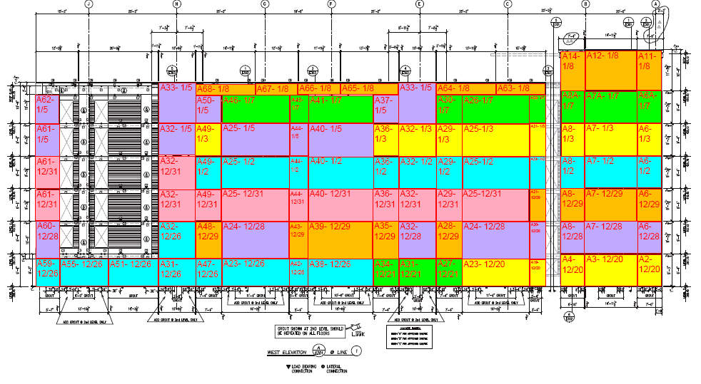
North Hall | American University |Washington D.C.
GPS Tracking of Precast Panels
North Hall | American University |Washington D.C.
Brandon Tezak |Construction Management
Brandon Tezak |Construction Management
Presentation Outline
Problem Identification
Limited Crane Usage
Compressed Project Schedule
Small Site Entrance
Goals
Keep Erection On Schedule
Keep Site Entrance Unblocked
Track Panel Testing
Background
8 Week Schedule
409 Panels
Testing of Welds & Bolted Connections
Manufactured in Oxford, NC
Project Background
Modularization of Suite Bathrooms
GPS Tracking of Precast Panels
Solar Panel Upgrade
Traditional Reinforced Concrete Slab
Summary of Conclusions & Acknowledgements

Slide 9
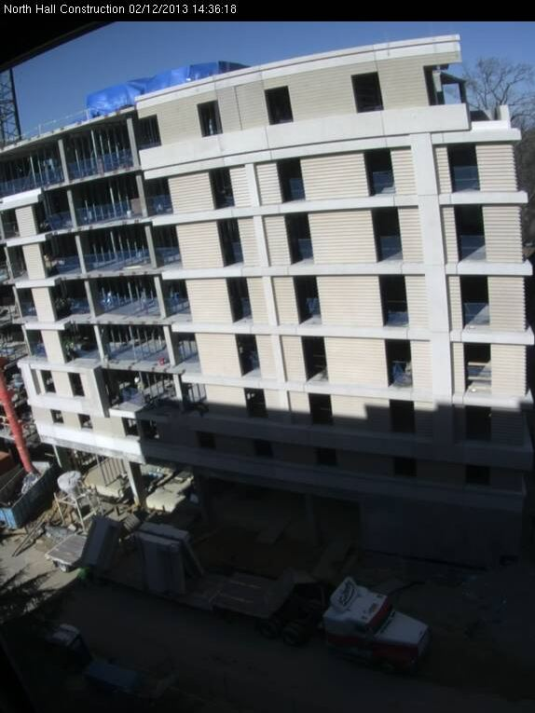
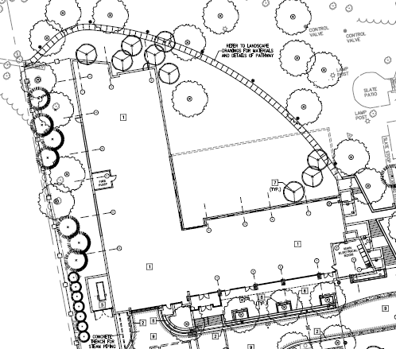
North Hall | American University |Washington D.C.
GPS Tracking of Precast Panels
North Hall | American University |Washington D.C.
Brandon Tezak |Construction Management
Brandon Tezak |Construction Management
Presentation Outline
Sequence
West Façade - Clockwise
Second Floor
Erection Problems
Not Enough Panels
Site Congestion
New Crane
Weather
Snow / Ice
High Winds
Project Background
Modularization of Suite Bathrooms
GPS Tracking of Precast Panels
Solar Panel Upgrade
Traditional Reinforced Concrete Slab
Summary of Conclusions & Acknowledgements

Slide 10
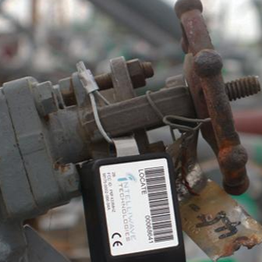
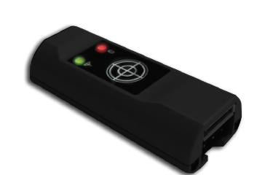
North Hall | American University |Washington D.C.
GPS Tracking of Precast Panels
North Hall | American University |Washington D.C.
Brandon Tezak |Construction Management
Brandon Tezak |Construction Management
Presentation Outline
System Needs
Real Time Location
Durable
Track Testing
Intelliwave Technology – SiteSense
Web-Based Software
Designed to Military Specs
7 Year Battery Life
Real Time Location
Electronic Document Tracking
GPS Insight – FT-1000
Web-Based Software
Will Work Inside Buildings
Real Time Location
Accelerometer
Small Size
Project Background
Modularization of Suite Bathrooms
GPS Tracking of Precast Panels
Solar Panel Upgrade
Traditional Reinforced Concrete Slab
Summary of Conclusions & Acknowledgements
Best Choice

Slide 11
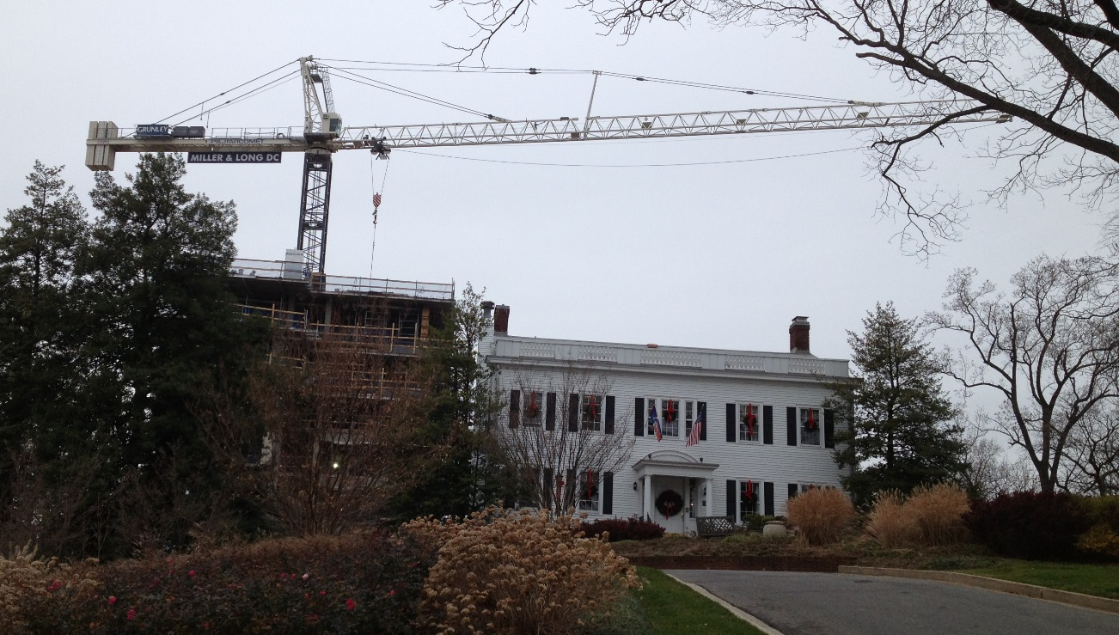
North Hall | American University |Washington D.C.
GPS Tracking of Precast Panels
North Hall | American University |Washington D.C.
Brandon Tezak |Construction Management
Brandon Tezak |Construction Management
Presentation Outline
Intelliwave Technology – SiteSense
Cost
309 Tags
Reuse First 100
Tag Cost: $108,150
$350 per tag
Service Fee: $4,635
$15 per Device per Month
2 Month Activation
Total Cost: $112,785
Eliminate Rental of New Crane
Approx. $3,150
Schedule Benefits
No New Crane
Minimize Project Delays
Keep Erection On Track
Project Background
Modularization of Suite Bathrooms
GPS Tracking of Precast Panels
Solar Panel Upgrade
Traditional Reinforced Concrete Slab
Summary of Conclusions & Acknowledgements

Slide 12
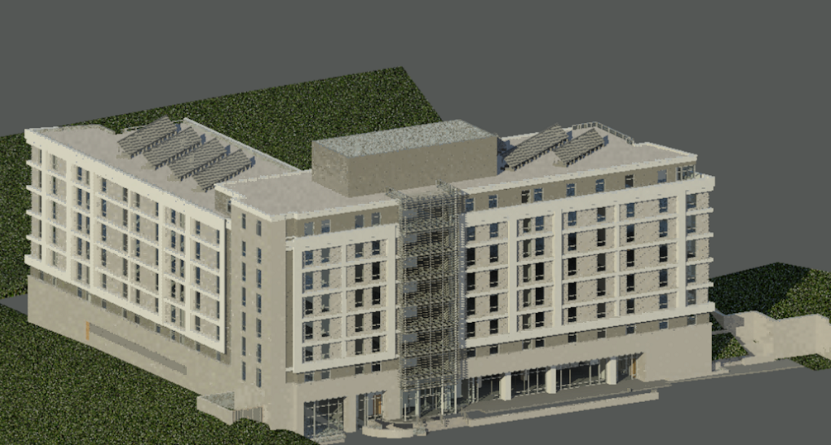
North Hall | American University |Washington D.C.
Solar Panel Upgrade
North Hall | American University |Washington D.C.
Brandon Tezak |Construction Management
Brandon Tezak |Construction Management
Presentation Outline
Problem Identification
Limited Capabilities of Current Design
Increasing Energy Costs
Goals
Increase Capability of System
Provide Energy Savings
Effectively Use Generated Electricity
Background
Current Design
Solar Hot Water
Two Groupings of Panels
7th Floor Roof
8th Floor Roof
Project Background
Modularization of Suite Bathrooms
GPS Tracking of Precast Panels
Solar Panel Upgrade
Traditional Reinforced Concrete Slab
Summary of Conclusions & Acknowledgements

Slide 13
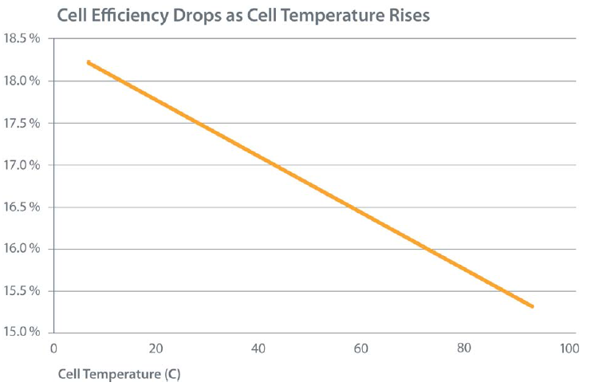
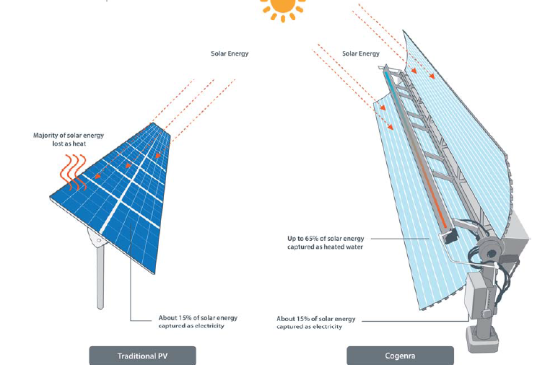
North Hall | American University |Washington D.C.
Solar Panel Upgrade
North Hall | American University |Washington D.C.
Brandon Tezak |Construction Management
Brandon Tezak |Construction Management
Presentation Outline
Cogeneration Panel
Solar Hot Water & Electrical Generation
Silicone Cell
Up to 75% Efficient
Sun Tracking
35% Increase in Energy Panel Sees
Project Background
Modularization of Suite Bathrooms
GPS Tracking of Precast Panels
Solar Panel Upgrade
Traditional Reinforced Concrete Slab
Summary of Conclusions & Acknowledgements
Image Source www.cogenera.com
Image From www.cogenera.com

Slide 14
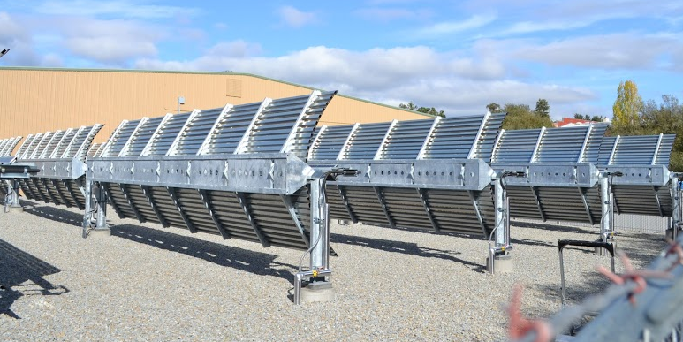
North Hall | American University |Washington D.C.
Solar Panel Upgrade
North Hall | American University |Washington D.C.
Brandon Tezak |Construction Management
Brandon Tezak |Construction Management
Presentation Outline
Cogeneration Panel Estimated Output
15 Modules
227 Kilowatts
Displacement
53,411 Kilowatt Hours per Year
10,431 Therms of Natural Gas per Year
Energy Costs
$.122 per Kilowatt-Hour
$ 1.112 per Therm of Natural Gas
North Hall Savings Per Year
$ 6,516 – Electrical
$ 11,600 –Natural Gas
$ 18,116 – Total
North Hall Average Solar Radiation
6.04 kWh/m^2/day
Project Background
Modularization of Suite Bathrooms
GPS Tracking of Precast Panels
Solar Panel Upgrade
Traditional Reinforced Concrete Slab
Summary of Conclusions & Acknowledgements
Image Source www.guntherportfolio.com

Slide 15
North Hall | American University |Washington D.C.
Solar Panel Upgrade
North Hall | American University |Washington D.C.
Brandon Tezak |Construction Management
Brandon Tezak |Construction Management
Presentation Outline
Cogeneration Panel Cost
Original Design ~ $ 125,000
Cogeneration Panel ~ $200,000
Payback Approx. 11 Years
Project Background
Modularization of Suite Bathrooms
GPS Tracking of Precast Panels
Solar Panel Upgrade
Traditional Reinforced Concrete Slab
Summary of Conclusions & Acknowledgements

Slide 16
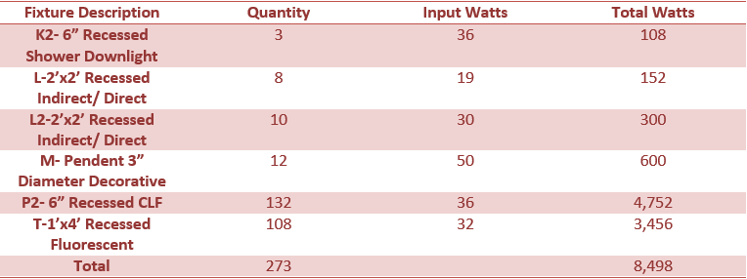
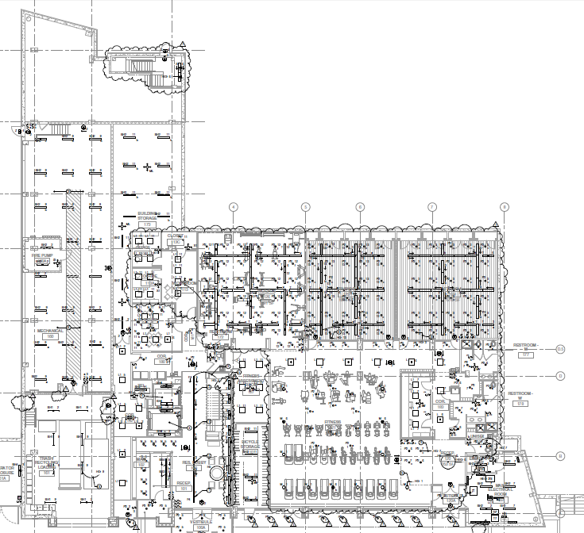
North Hall | American University |Washington D.C.
Solar Panel Upgrade
North Hall | American University |Washington D.C.
Brandon Tezak |Construction Management
Brandon Tezak |Construction Management
Presentation Outline
North Hall Fitness Center
Fitness Center Lighting
Used 16 Hours a Day
Used Every Day
Requires 49,628 kWh per year
Available 53,411 kWh per year
Project Background
Modularization of Suite Bathrooms
GPS Tracking of Precast Panels
Solar Panel Upgrade
Traditional Reinforced Concrete Slab
Summary of Conclusions & Acknowledgements

Slide 17
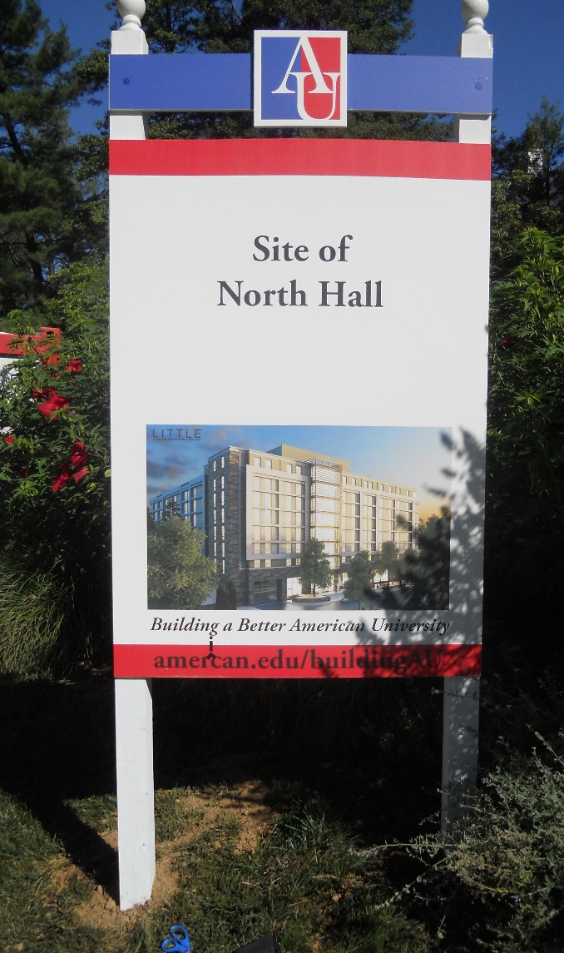
North Hall | American University |Washington D.C.
Summary of Conclusions
North Hall | American University |Washington D.C.
Brandon Tezak |Construction Management
Brandon Tezak |Construction Management
Presentation Outline
Analysis 1 – Modularization of Suite Bathrooms
Cost Savings: Increase of $92,315.52
Schedule Savings: 66 Days (13.2 Weeks)
Recommended
Analysis 2 – GPS Tracking of Precast Panels
Cost Savings: Increase of $112,785
Schedule Savings: 5 Days (1 Week)
NOT Recommended
Analysis 3 – Solar Panel Upgrade
Cost Savings: Initial Cost of $200,000, Payback in 11 Years
Schedule Savings: None
Recommended
Analysis 4 – Traditional Reinforced Concrete Slab
Cost Savings: Increase of $168,647
Schedule Savings: None
NOT Recommended
Project Background
Modularization of Suite Bathrooms
GPS Tracking of Precast Panels
Solar Panel Upgrade
Traditional Reinforced Concrete Slab
Summary of Conclusions & Acknowledgements

Slide 18
North Hall | American University |Washington D.C.
Questions & Acknowledgments
North Hall | American University |Washington D.C.
Brandon Tezak |Construction Management
Brandon Tezak |Construction Management
Presentation Outline
Questions?
Acknowledgments
My Family and Friends
Dr. Chimay Anumba
Greg McHugh, Grunley Construction Company
Justin Ingram, Grunley Construction Company
Mike Kenney, Grunley Construction Company
Rob Soper, Grunley Construction Company
American University
AE Classmates
Project Background
Modularization of Suite Bathrooms
GPS Tracking of Precast Panels
Solar Panel Upgrade
Traditional Reinforced Concrete Slab
Summary of Conclusions & Acknowledgements

